Slide 1
Access Control
Chester Rebeiro
Indian Institute of Technology Madras

Slide 2
Cache Covert Channel
Processes
Processor
Cache
Memory
Memory

Slide 3
Cache Covert Channel
Processes
cache line
Processor
way
Cache
Memory
cache set
Memory

Slide 4
Cache Covert Channel
address
tag
set
line
cache line
chooses one set

Slide 5
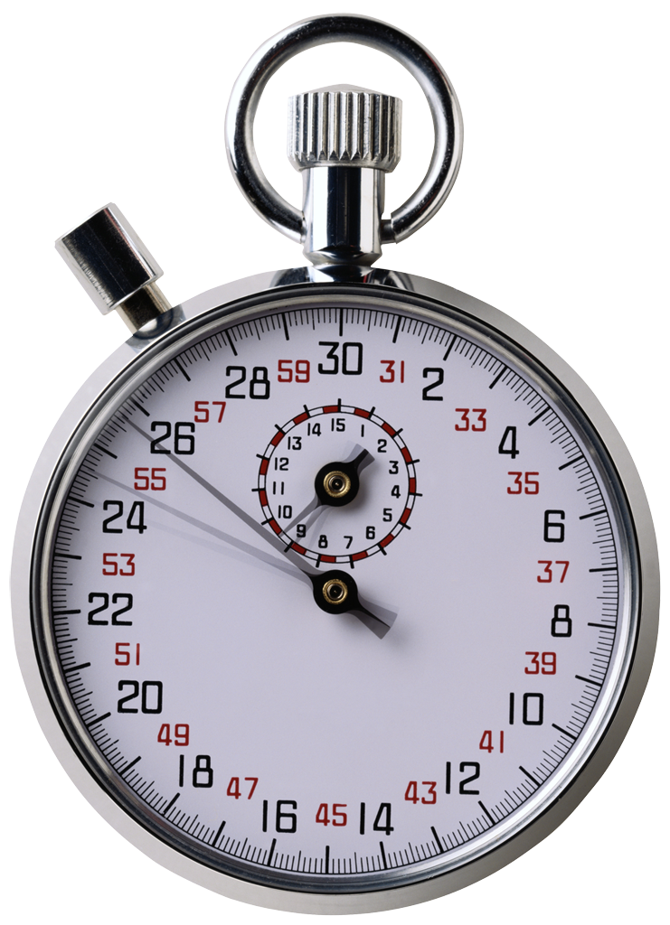
Cache Covert Channel
while(1){
load A1_{p2}; load A2_{p2}
load A3_{p2}; load A4_{p2}
load B1_{p2}; load B2_{p2}
load B3_{p2}; load B4_{p2}
}
Process P2
statistically
time A ~ time B
A Set
B Set

Slide 6
Cache Covert Channel
while(1){
load A1_{p2}; load A2_{p2}
load A3_{p2}; load A4_{p2}
load B1_{p2}; load B2_{p2}
load B3_{p2}; load B4_{p2}
}
Process P1
Process P2
statistically
time A > time B
If (bit == 1) load A_{P1}
Else
load B_{P1}
A Set
B Set

Slide 7
Cache Covert Channel
while(1){
load A1_{p2}; load A2_{p2}
load A3_{p2}; load A4_{p2}
load B1_{p2}; load B2_{p2}
load B3_{p2}; load B4_{p2}
}
Process P1
Process P2
statistically
time A < time B
If (bit == 1) load A_{P1}
Else
load B_{P1}
A Set
B Set

Slide 8
Cache Covert Channel
while(1){
load A1_{p2}; load A2_{p2}
load A3_{p2}; load A4_{p2}
load B1_{p2}; load B2_{p2}
load B3_{p2}; load B4_{p2}
}
Process P1
Process P2
statistically
time A < time B
bit = message
while(bit[i] != ‘\0’)
for(some number of iterations)
If (bit[i] == 1) load A_{P1}
else
load B_{P1}

Slide 9
Covert Channels
Identifying: Not easy because simple things like the existence of a file, time, etc. could be a source for a covert channel.
Quantification: communication rate (bps)
Elimination: Careful design, separation, characteristics of operation (eg. rate of opening / closing a file)

